Slide 1
Java Collections

Slide 2
Collection in Java is a framework which contains set of classes and interfaces, that provides an architecture to store and manipulate the group of objects.
It is a single unit of objects.
You can perform operations on data such as searching, sorting, insertion, manipulation, and deletion.

Slide 3
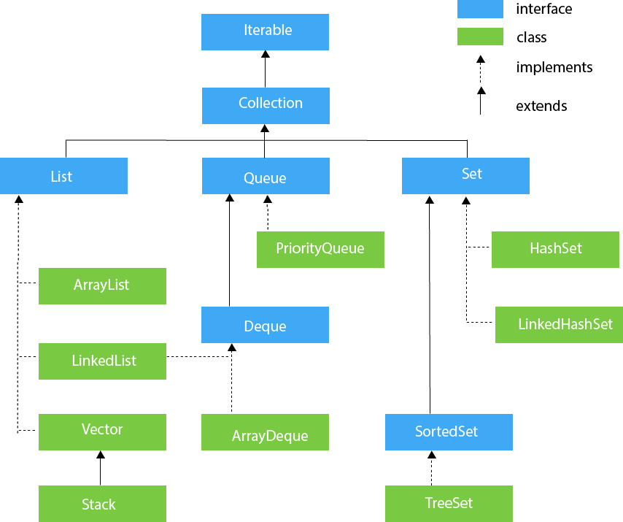
Collection Framework

Slide 4
ArrayList
The ArrayList class implements the List interface
ArayList class is resizable (Dynamic) array
ArrayList is found in java.util package
Syntex for creating array list
ArrayList<data-type> obj = new ArrayList<data_type>();

Slide 5
ArrayList method
ArrayList class has many useful method
    Add()
    Get()
    Set()
    Remove()
    indexOf()
    Size()

